Slide 1



LMS Launch Plan
Helping organizations get their online training program off the ground seamlessly.
www.knowledgeanywhere.com

Slide 2

30 Days Prior to Launch
*Note: Some of these items might need to begin earlier depending upon the level of brand and cross-functional approval required
Finalize Name and Tagline for Learning System
Establish goals for system (e.g., 1,000 new users by March 25, 5,000 users by April 20, and 3,000 completed courses by July 20, etc.).
Begin creating/ordering printed material (collateral, table tents, etc.)
Begin building introduction external communication (if system is customer facing)
  Email
  Website
  Social Media
  Newsletter
  Customer Events
Begin building introduction internal communication
  Email
  Website
  Social Media
  Employee Newsletter
  Posters and Table Tents

Slide 3

30 Days Prior to Launch (cont.)
*Note: Some of these items might need to begin earlier depending upon the level of brand and cross-functional approval required
Send brief internal communication to leadership and solicit any feedback
Send brief description to line management on their responsibilities and solicit feedback
Set up and attend customer or technical support meeting to share the system
Assign individuals who will handle technical support emails and calls
Prepare a Frequently Asked Question (FAQ) Sheet (include how they will contact support)
Set up an email alias for technical support questions
Send a “teaser” email out (e.g., “Something new is coming your way in 30 days…”)
Prepare press release if system is external facing
Build structure for contest or incentive program
Other

Slide 4

7 Days Prior to Launch
Send internal communication to leadership regarding the new system and goals
Send communication to line management confirming their responsibilities
Pilot communication with a few users to ensure the instructions are clear
Send email to customer-facing system regarding the new system with the FAQ
Mail out printed material
Finalize customer email communication, email list, and distribution delivery method
Develop a brief video introduction
Other

Slide 5
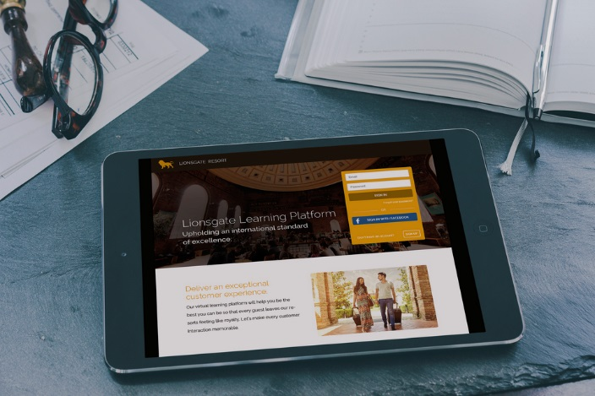
At Launch
Send email communication regarding new system and how to access to the system. Include how they will contact support.
Post announcement (Web, Internal sites, LinkedIn, Twitter)
Post physical collateral
Suggest adding note on customer-facing email signature (e.g., “See our new learning system at…”)
Test email alias for immediate response
Send reinforcement communication to line management on their responsibilities
Build list of questions to improve instructions and or FAQ
Send Press Release
Announce contest or incentive
Post video overview and introduction
Other

Slide 6

30 Days Post-Launch
Send email communication regarding new program and how to access to the system
Update instruction based upon questions and feedback
Review learner feedback
Review results compared to pre-established goals
Update leadership team on progress
Thank team who participated in the development
Update announcement on website
Touch base with customer service and technical support on awareness and questions
Other

Slide 7

60 Days Post-Launch
Send out notice on new courses available
Audit responses to learners’ questions and suggestions
Review learner feedback and look for areas to improve
Post positive comments from learners
Review results compared to pre-established goals
Update leadership team on progress
Provide an update on contest
Complete post launch review with the team. What went well and what could be improved on?
Other

Slide 8

Ongoing
Send out notice on new courses available
Post positive comments from learners
Review results compared to pre-established goals
Update leadership team on progress

Slide 9



Need Help?
Get started with these great resources.
Video Tutorials
http://www.knowledgeanywhere.com/resources/videos
Help Center
https://knowany.zendesk.com/hc/en-us
Articles + Guides
http://www.knowledgeanywhere.com/resources

