Slide 1
LMS Features & Benefits
11 ways our LMS can help both learners and administrators get the most out of online training

Slide 2

Learner Experience
Simple, user-friendly training delivered to today’s learner

Slide 3
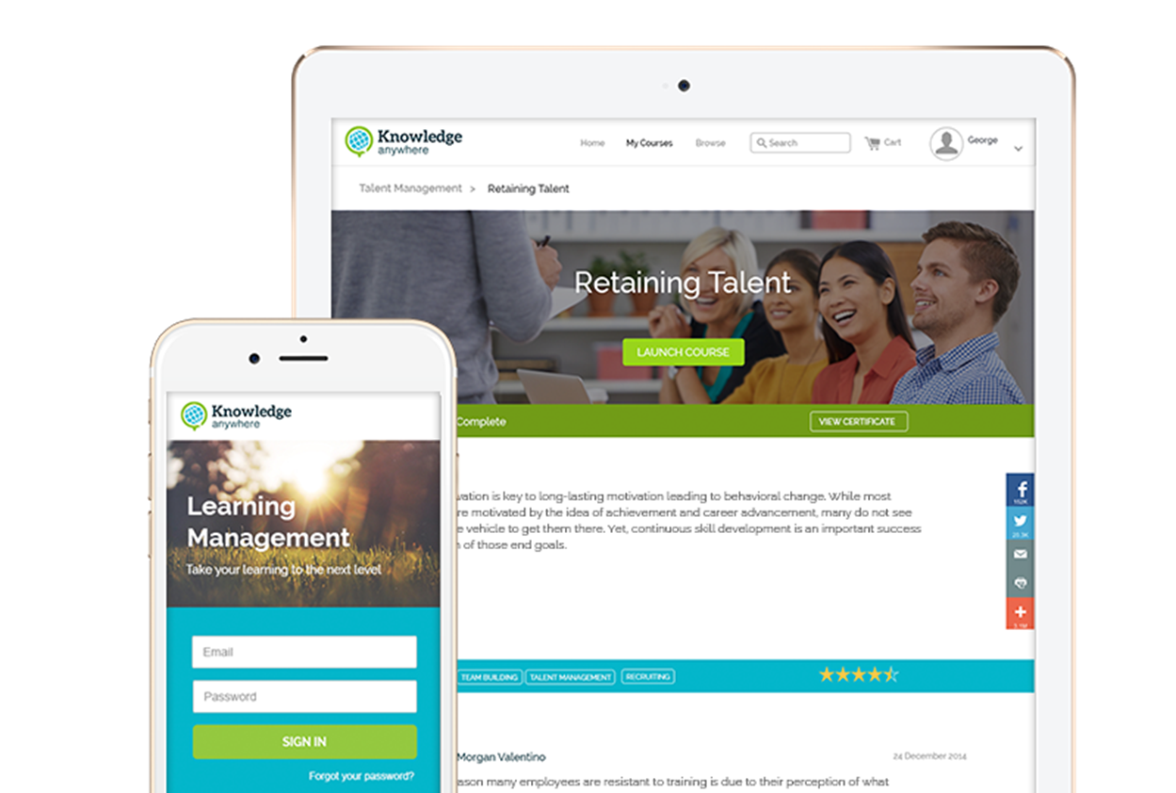
Learn anywhere, anytime
A fully-responsive LMS allows you to extend training past the cubicle or conference room to reach your audience on virtually any device and at their own pace.
Learners can log in, access their course catalog, view their transcript, leave course comments, and more―all from their mobile device.

Slide 4
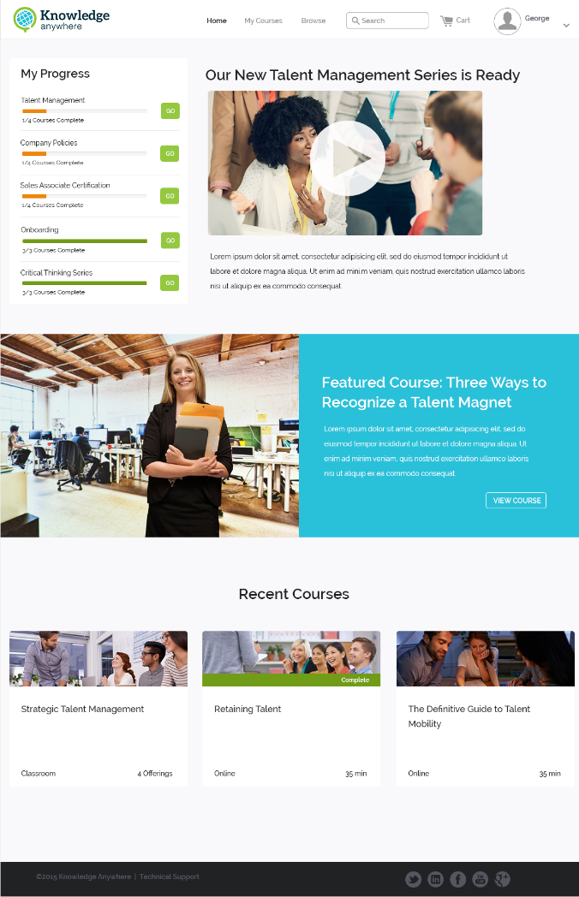

Find everything, right from the homepage
Learners have instant visibility into their training progress in the “My Progress” section on the Learner home page.
Learners can quickly register for or jump to an important, featured course in just one click.
Learners can quickly resume the most recent courses they’ve accessed, eliminating guesswork if it’s been a while since their last login.

Slide 5
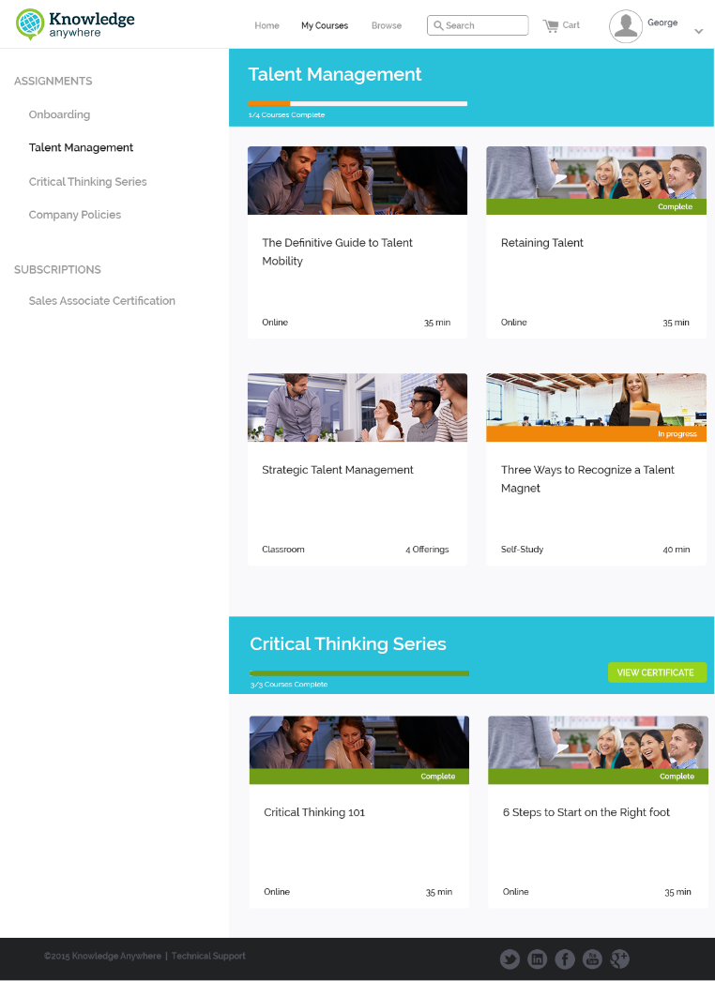

Take assigned, purchased, or optional courses
The navigation menu on the left makes it easy for learners to see which learning paths are assigned to them as well as which are available to purchase for further (optional) enrichment.
Visibility into a learner’s training progress is reinforced by a training progress bar for each learning path.

Slide 6
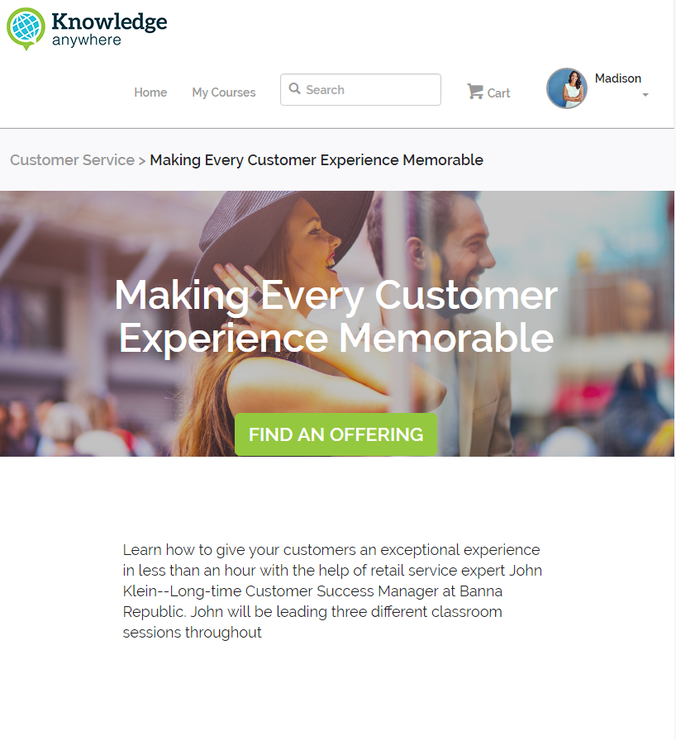
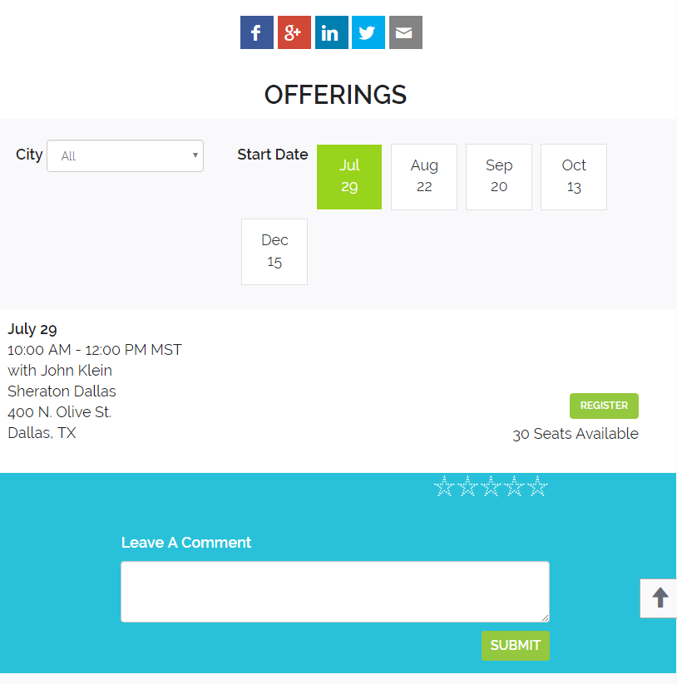
Register for a time that works best for your schedule
Learners can take an instructor-led classroom course at a time and location that is best for their schedule with our easy-scheduling tool.
After completing a course, learners can leave a course comment, take a course survey, or share that they’ve completed the course to social media (optional).

Slide 7
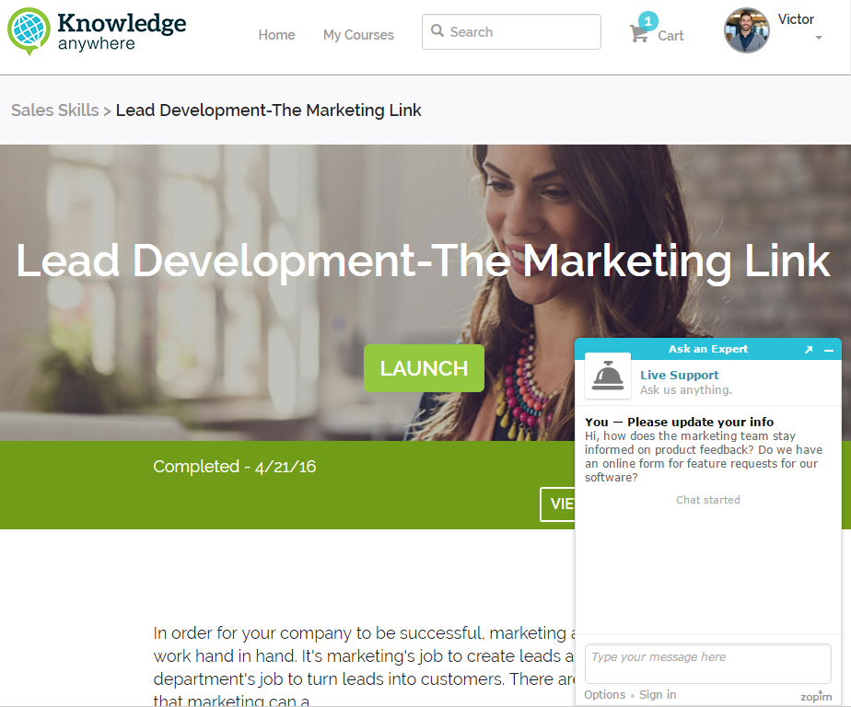
Find answers instantly
Learners can ask administrators or instructors questions in real-time with the live chat feature―minimizing learner confusion and helping to humanize the online learning experience.

Slide 8
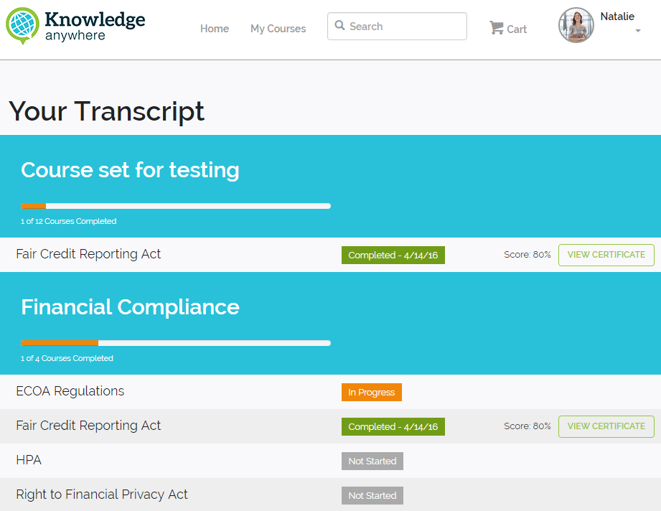
Monitor training progress & download certificates
A transcript makes it easy for learners to see how they are making progress toward completing their training and gives them easy access to all certificates they have earned through the virtual training portal.

Slide 9

Administrative Experience
Intuitive and powerful delivery, management, and reporting for the need-to-know administrator

Slide 10
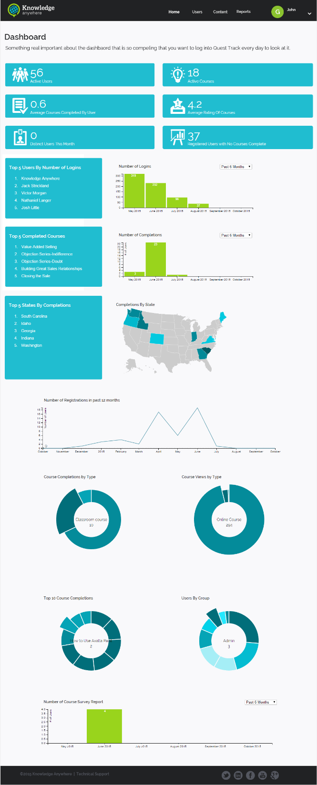
Collect and measure meaningful data
Administrators get a bird’s-eye view into the data that are most important to them with our dynamic and intuitive reporting Dashboard.
Further drill-down reporting is available within the Reports tab of the LMS. All reports can be exported to Excel.

Slide 11
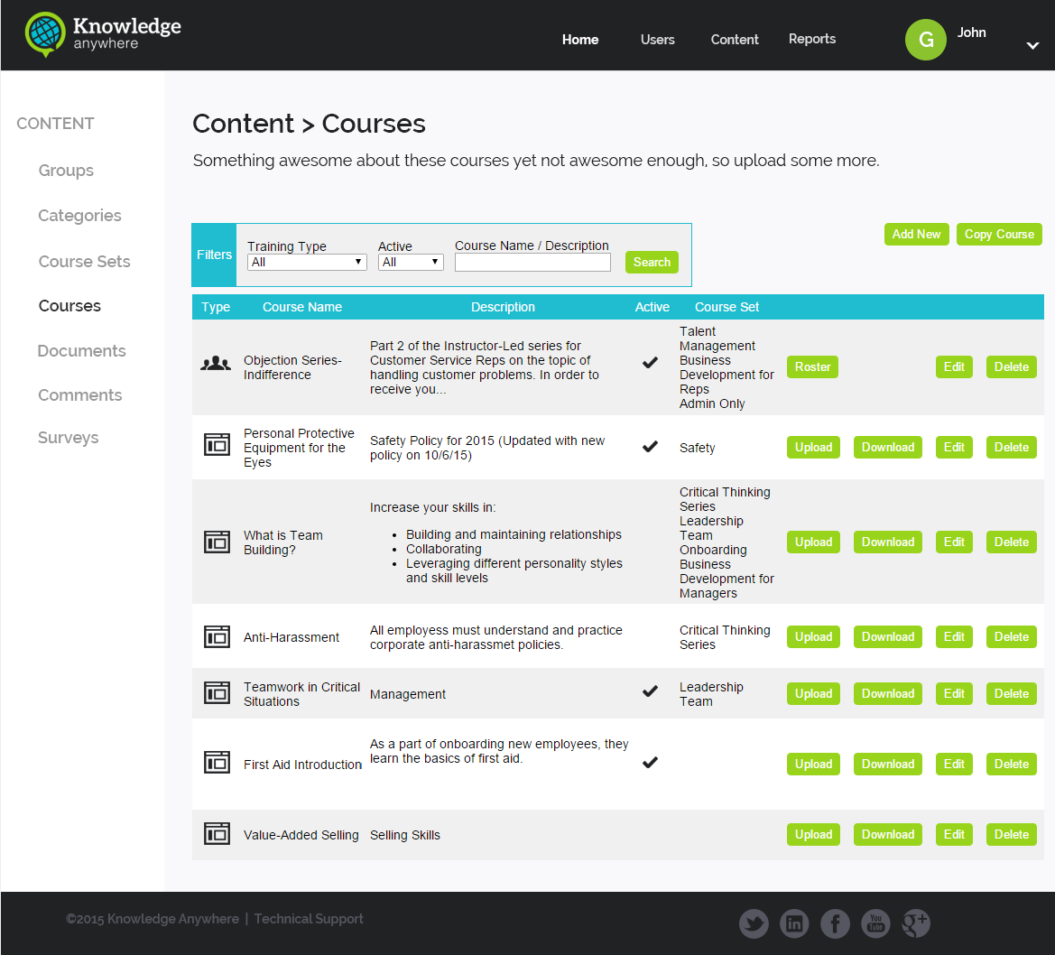
Deliver and manage content with ease
With our centralized learning platform, you can deliver online courses, self-study courses (such as webinars), instructor-led classroom courses, assessments, certifications, and compliance content on virtually any mobile device.
Adding a course is simple and takes as little as five minutes per course to set up. For online courses, all you need is a SCORM-compliant course file and you’re ready to go!

Slide 12
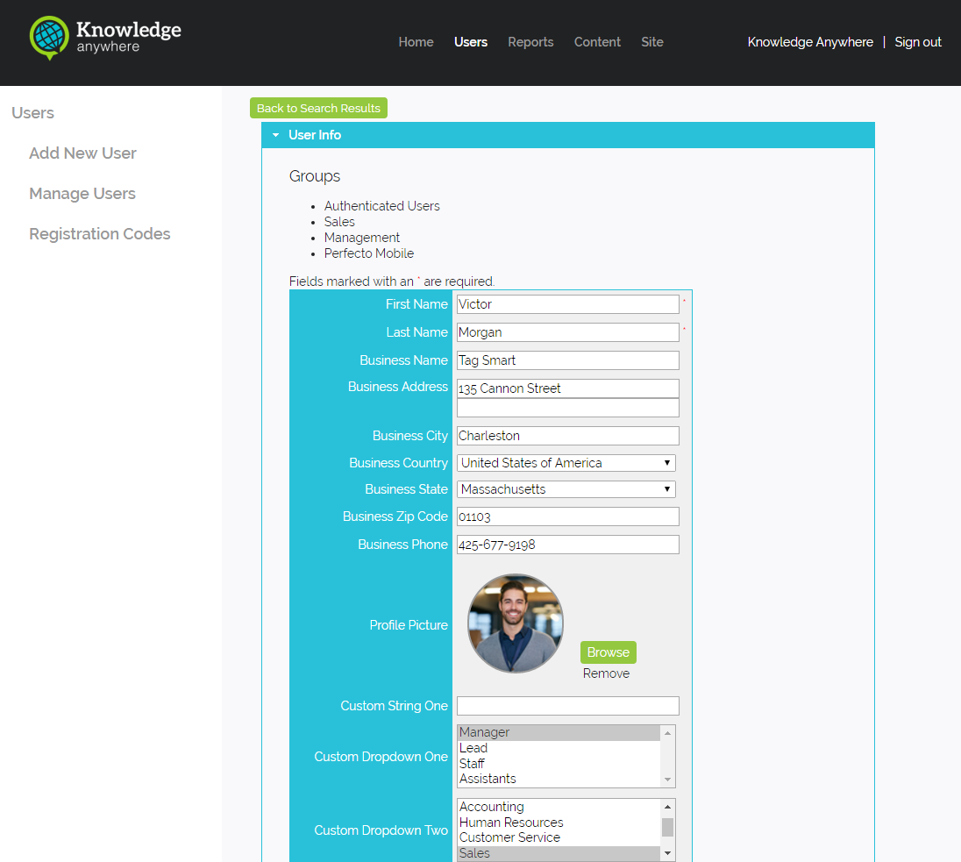
Manage users effortlessly
Administrators can quickly add new users, manage user profiles, and email learners directly through the LMS.
Administrators can assign curriculum to learners based on user roles, departments, or any other custom factor—making it fast and easy to manage learning tracks or certification pathways.

Slide 13
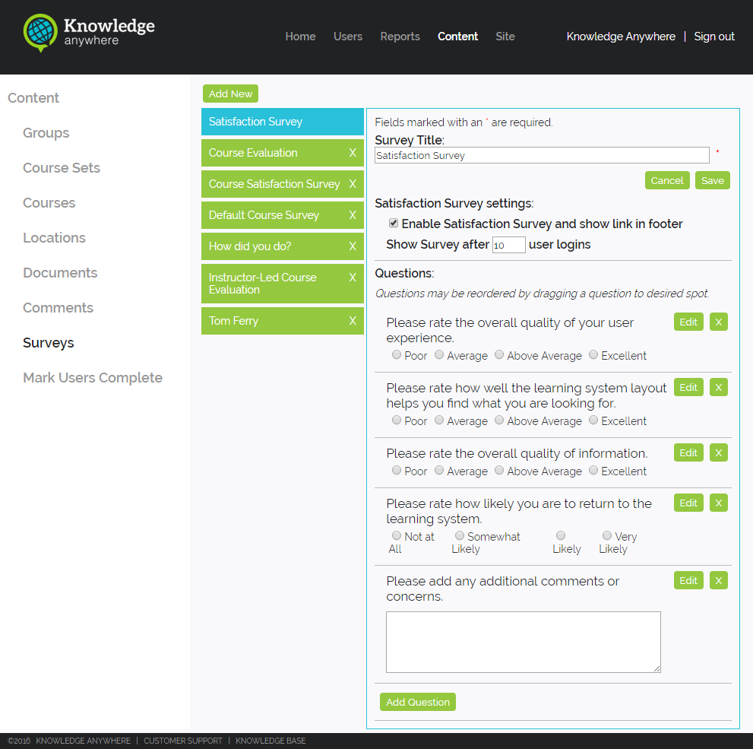
Get learner feedback.
Ensure your courses are up to par with post-course surveys that glean important learner feedback and satisfaction.
Administrators can select from an array of question types to build unique surveys at the course or learning path level.

Slide 14
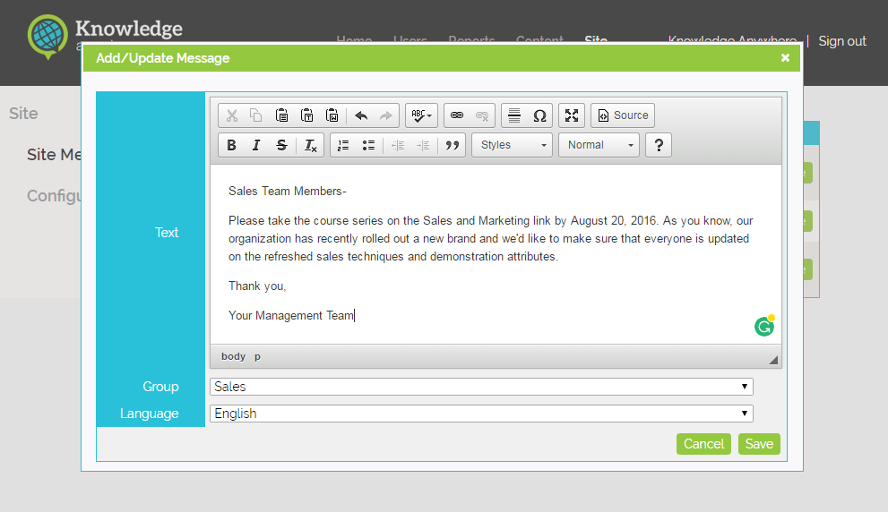
Display group-specific messages
Convey important company updates, content changes, event registrations, and more with group-specific announcements on the Learner home page. You can even display messages in other languages (optional).

Slide 15



Helpful Resources
 | Video Tutorials https://www.knowledgeanywhere.com/resources/videos
 | Help Center https://knowany.zendesk.com/hc/en-us
 | Articles + Guides https://www.knowledgeanywhere.com/resources/guides

